Slide 1
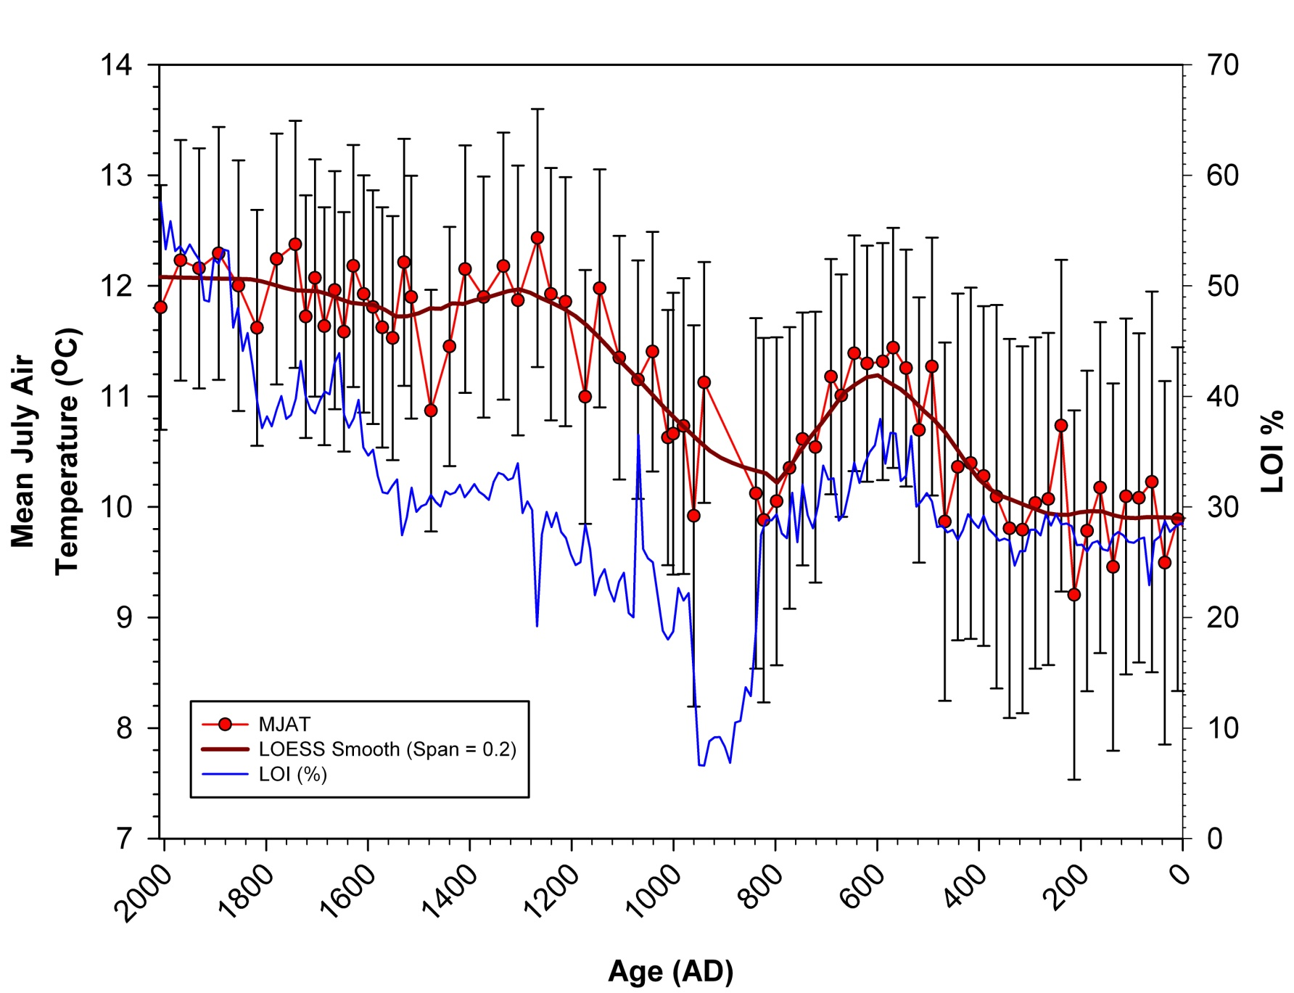
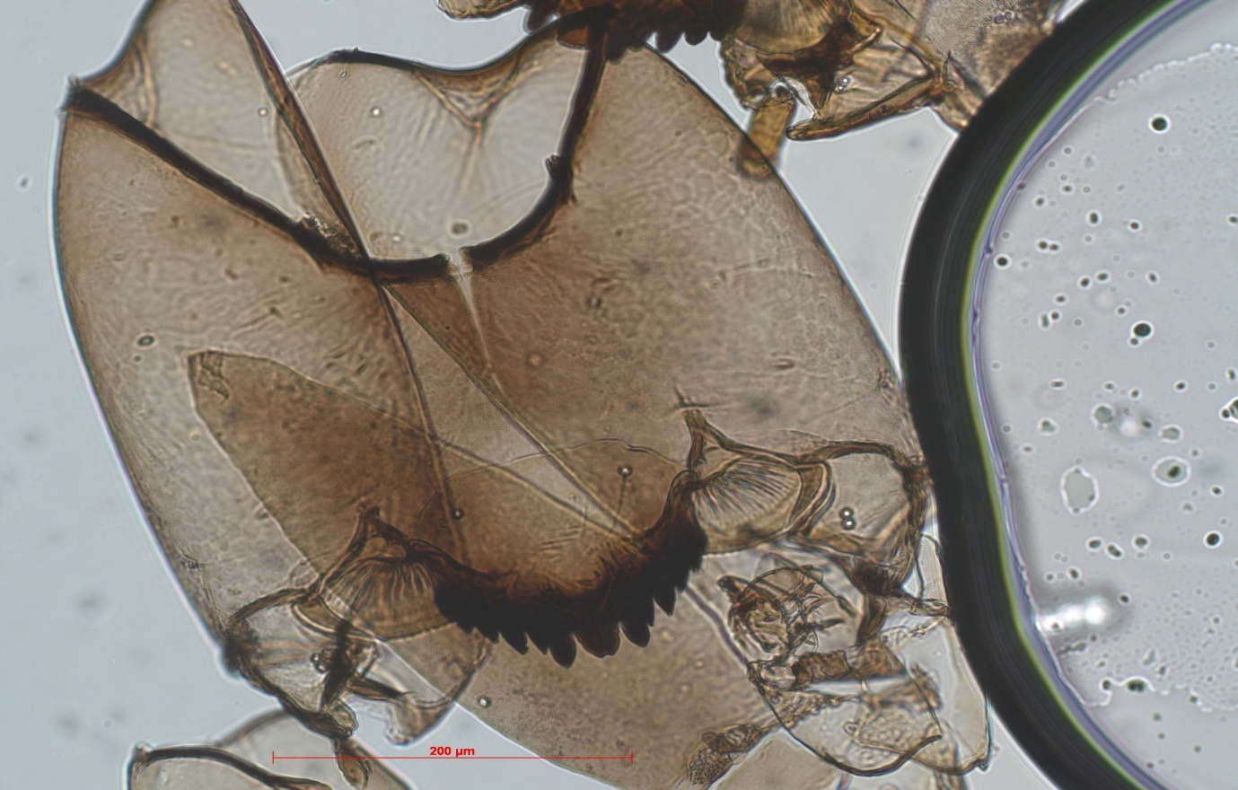
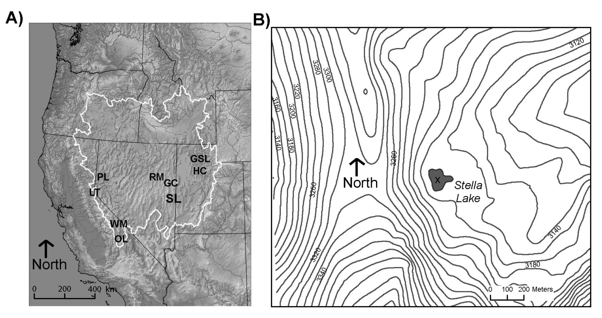
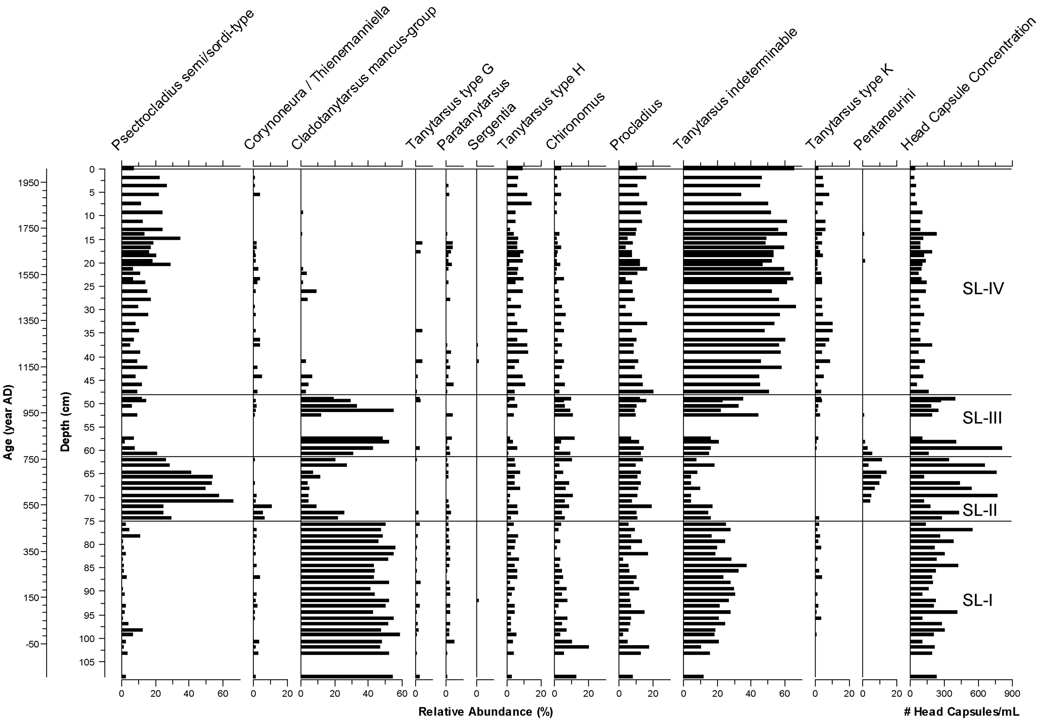
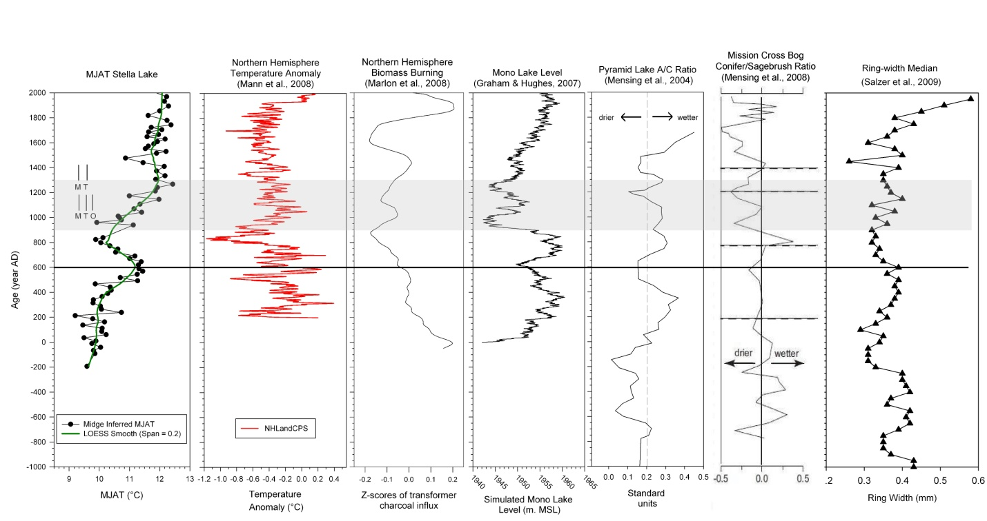
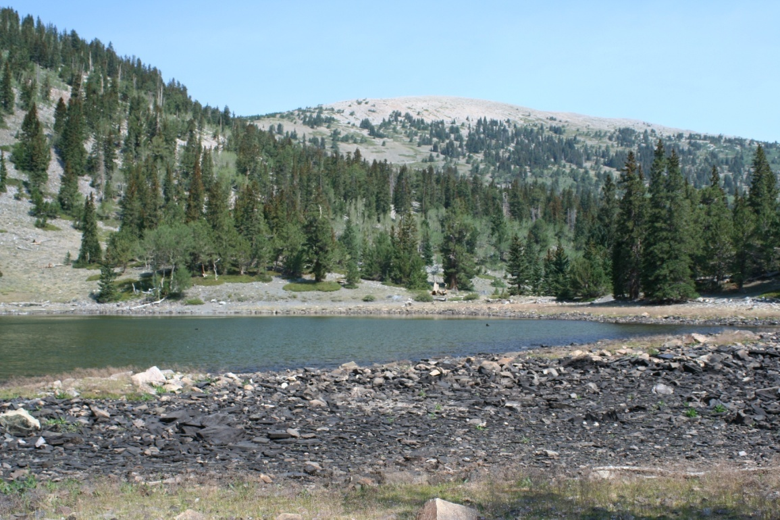
A Multidecadal Midge-Based Temperature Reconstruction From the Great Basin, United States Provides Evidence of Warmer Conditions During The Medieval Climatic Anomaly
Scott Reinemann¹ and David Porinchu¹
¹Department of Geography, The Ohio State University
Introduction
Lab Code | Depth (cm) | Material | ¹⁴C yr BP ± 1σ | 2σ age Range (cal yr BP) | Relative area under Distribution | Calibrated Age (cal yr BP)
OS-64661 | 33.0 | Conifer Needle | 185 ± 30 | 137 - 224 | 0.556 | 180.5
262566 | 67.75 | Conifer Needle | 1250 ± 40 | 1076 -1276 | 1.000 | 1230
262567 | 75.0 | Conifer Needle | 1640 ± 75 | 1373 -1711 | 1.000 | 1520
OS-64648 | 112.5 | Plant/Wood | 2080 ± 35 | 1985 - 2145 | 0.955 | 2065
OS-64661 | 233.0 | Plant/Wood | 3920 ± 35 | 4242 - 4438 | 0.990 | 4340
OS-64649 | 320.5 | Plant/Wood | 5970 ± 40 | 6713 - 6902 | 0.962 | 6810
The Great Basin has experienced large fluctuations in its thermal and precipitation regimes during the late Holocene. Understanding the nature and causes of this variability is crucial given how important and potentially limiting water resources are in this region.
The Medieval Climatic Anomaly (MCA) (900-1300 AD) is the most recent interval of warmth, comparable to present. Detailed study of the MCA places modern climate variability into context and may inform our understanding of future conditions.
The remains of chironomids (Fig. 1) preserved in the sediment of Stella Lake, a small climatically sensitive lake located in Great Basin National Park (GBNP) were used to quantitatively reconstruct long-term changes in the temperature regime of the region.
Improving our understanding of thermal regimes during the MCA is critical given the major role temperature plays in controlling effective moisture balance in arid environments, such as the Great Basin.
The MJAT then remained relatively constant from 1300 AD to present, with minor fluctuations (Fig. 6).
Table 1: AMS ¹⁴C dates for the Stella Lake.
A chironomid-based Mean July Air Temperature (MJAT) inference model designed specifically for use in the Great Basin was developed using a weighted-averaging partial least squares (WA-PLS) approach (Porinchu et al., 2010) and applied to the sub-fossil midge assemblages.
Fig. 6 Loss-on-Ignition (LOI) (blue line), chironomid-inferred MJAT (°C)(red line with circles), sample specific error (°C)(black lines), LOWESS smooth (span = 0.20) of chironomid-inferred MJAT (thick red line).
Results and Discussion
Conclusions
A total of 12 midge taxa were identified in the Stella Lake core (Fig. 4). The midge community experienced significant compositional turnover throughout the ~2000 yr record.
The major taxa comprising the MCA midge community are: Psectrocladius semicirculatus/sordidellus, Procladius and Tanytarsus.
The interval between 0 AD and 400 AD was characterized by low midge-inferred MJAT of ~10.0°C.
MJAT experienced a sharp rise and fall between 400 AD and 800 AD reaching a maximum of ~11.2°C (Fig. 6).
The midge-based MJAT inferences indicate that during the MCA the central Great Basin was characterized by an increase in temperature of ~1.5°C (Fig. 6).
The Stella Lake record broadens our knowledge of the thermal conditions that existed during the last 2000 yrs in the Great Basin by providing an independent quantitative reconstruction of MJAT.
The warming that occurs at ~600 AD appears to correspond to regional records of warmth and aridity.
The warming during the MCA corresponds to global records of increasing temperature and biomass burning (Fig. 7). The warming is also aligned with a regional picture of increased aridity.
This and future quantitative reconstructions of past thermal conditions will enable an examination of the influence of temperature on aridity in the Great Basin.
VMP
Fig.1: Photomicrograph of a Dicrotendipes head capsule (scale bar is 50 μm). VMP = ventromental plate
Fig.2: (a) Map of study site and locations of other regional records. Stella Lake = SL. (b) Stella Lake study site (x = coring location).
Study Site and Methodology
A 328 cm sediment core was recovered from Stella Lake (Fig. 3), a small (~ 3ha), shallow (2.0m), high elevation (3,150m) lake in August 2007.
Loss-on-Ignition (LOI) analysis was conducted at 0.5 cm resolution following Heiri et al. (2001).
Fig. 3 Stella Lake, Great Basin N. P. (August 2007)
Fig. 7 Summary diagram of existing selected paleoclimate records and data from Stella Lake.
Chronological control was provided by six ¹⁴C AMS dates on
terrestrial macro-fossils (Table 1).
Sub-fossil midge remains were identified and enumerated (n=78, ~25 year resolution).
Acknowledgements: We would like to thank Gretchen Baker (Staff Ecologist, Great Basin National Park, GBNP) and Andy Ferguson (Superintendent, GBNP) for providing access to the research sites and facilitating our research, and Terry and Debbie Steadman for providing logistical support and local knowledge. We would also like to thank Jim DeGrand for his unyielding assistance in the field. We acknowledge The Western National Park Association (WPNA) and Department of Geography at The Ohio State University for funding this research.
Fig. 4 Chironomid relative abundance diagram for Stella Lake.

